Slide 1
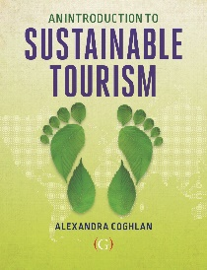

Ethics and sustainable tourism
Lecture 6
© Alexandra Coghlan 2019 Introduction to Sustainable Tourism

Slide 2
A sequence of thinking about tourism
Stagnation in sustainable tourism?
Advocacy platform
Cautionary platform
Adaptancy platform
Knowledge-based platform
Sustainability-oriented platform
Ethics based platform
© Alexandra Coghlan 2019 Introduction to Sustainable Tourism

Slide 3

Ethics
© Alexandra Coghlan 2019 Introduction to Sustainable Tourism
It’s a slippery term!
Ask business people “what does ethics mean to you?”
"Ethics has to do with what my feelings tell me is right or wrong."
"Ethics has to do with my religious beliefs.“
"Being ethical is doing what the law requires.“
"Ethics consists of the standards of behavior our society accepts”
"I don't know what the word means”
Ethics is concerned with moral judgments, standards and rules of conduct

Slide 4
Sustainable tourism and ethics
But 5 reasons why tourism is suited to ethical considerations:
It is an activity focussed on human behaviour.
It includes several different actors representing a range of perspectives and objectives.
It has an applied context.
It has social, cultural, economic, ecological and political dimensions.
It can create a range of different combinations of impacts in a wide variety of contexts across the globe.
“the absence of ethical leadership
in the tourism industry has been
truly ‘astounding”
(Donyadide, 2010, p.429)
© Alexandra Coghlan 2019 Introduction to Sustainable Tourism

Slide 5


Why do we not talk about ethics in business?
Moral Muteness is:
Not speaking up when witnessing unethical behaviour
The unwillingness to discuss ethics
Discussing practices/decisions in a way that obscures your moral position and ethical beliefs
(Bird & Walters, 1989):
What causes moral muteness?
Discussions of ethics can be threatening to harmony, efficiency or power.
© Alexandra Coghlan 2019 Introduction to Sustainable Tourism

Slide 6
Ethics 101:
Deontology:
moral duty, moral rules always apply, no room for alternatives. Code of ethics.
Utilitarianism:
looks for greatest good from that action, each situation must be evaluated according to actors, context and consequences.
Relativism:
morals evolve and change with social norms over a period of time, and it is up to the individual to establish his or her own moral compass (subjective relativism) or act in accordance with their socio-cultural norms of right and wrong (cultural relativism).
Virtue ethics/phronesis –
practice of virtues with discretion and with good intent.
© Alexandra Coghlan 2019 Introduction to Sustainable Tourism

Slide 7
Empirical evidence for the importance of personal ethics in sustainable tourism
THE CARE FACTOR!
?? Surveyed 1945 Latin American accommodation providers and measured individualism/collectivism influences on sustainability practices – what they did and why?
Examples of sustainability practices surveyed:
Save energy, save water, encourage customers to be environmentally friendly, use biodegradable products, conserve local wildlife, choose suppliers that demonstrate social responsibility, etc.
Examples of motivations:
To protect the environment, for marketing and image benefits, it’s a personal/lifestyle choice, to obtain subsidies and grants, because it’s easy to implement
MOST SUSTAINABILITY ACTIONS WERE DRIVEN BY A SENSE OF PERSONAL RESPONSIBILITY OR CARE FOR OTHERS!
© Alexandra Coghlan 2019 Introduction to Sustainable Tourism

Slide 8
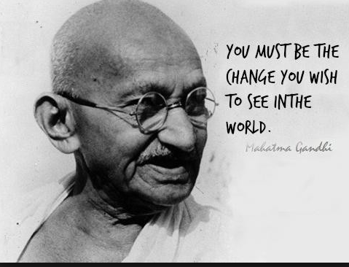
A WORD ABOUT RELATIVISM….
What are social norms:
“mental representations of appropriate behavior”
e.g. using coffee cups, recycling, straws, car use, carbon offsets when flying.
“But I am only one person”
Vs
“Be the change you want to see in the world”

Slide 9
Sustainability is a “value-driven journey, influenced primarily by the development of environmental consciousness and personal, socio-cultural and situational factors of the individual business-owners” (Garay & Font, 2015, p.336).
How do we progress towards sustainability
At an individual level
At a business level
At a sectoral level
© Alexandra Coghlan 2019 Introduction to Sustainable Tourism

Slide 10
1. How an individual considers ethics in decision-making
Four basic steps to ethical decision-making, based on Rest’s (1986) Moral Dilemmas
recognizing a moral issue,
making a moral judgment,
establishing moral intent, and
engaging in moral behaviour or action.
© Alexandra Coghlan 2019 Introduction to Sustainable Tourism

Slide 11

Additional considerations
Moral intensity of an issue and a sense of moral agency (Jones, 1991),
Cognitive effort, i.e. the diligent evaluation of relevant information (Street et al. 1997)
Thinking styles, emotional vs rational (Groves, Vance & Paik, 2007)
Preference projection (Brenner & Bilgin, 2011)
False Consensus Bias (Wiltermuch et al, 2013)
© Alexandra Coghlan 2019 Introduction to Sustainable Tourism

Slide 12
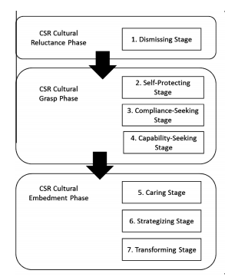
2. How a business progresses to sustainability
3 phases in developing sustainability practices
Cultural Reluctance – focus is on short-term financial gains and actively opposes to any other initiatives
Cultural Grasp – an understanding of social and environmental damage, practices modified to include some sustainability principles
Cultural Embedment – sustainability embraced, and viewed as opportunity for innovation. Long-term thinking and “other” focus
© Alexandra Coghlan 2019 Introduction to Sustainable Tourism

Slide 13
3. At a sector level
WTO’s Global Code of Ethics for Tourism.
Article 1: | Tourism's contribution to mutual understanding & respect between peoples & societies
Article 2: | Tourism as a vehicle for individual and collective fulfilment
Article 3: | Tourism, a factor of sustainable development
Article 4: | Tourism, a user of the cultural heritage of mankind and contributor to its enhancement
Article 5: | Tourism, a beneficial activity for host countries and communities
Article 6: | Obligations of stakeholders in tourism development
Article 7: | Right to tourism
Article 8: | Liberty of tourist movements
Article 9: | Rights of the workers and entrepreneurs in the tourism industry
Article 10: | Implementation of the principles of the Global Code of Ethics for Tourism

Slide 14
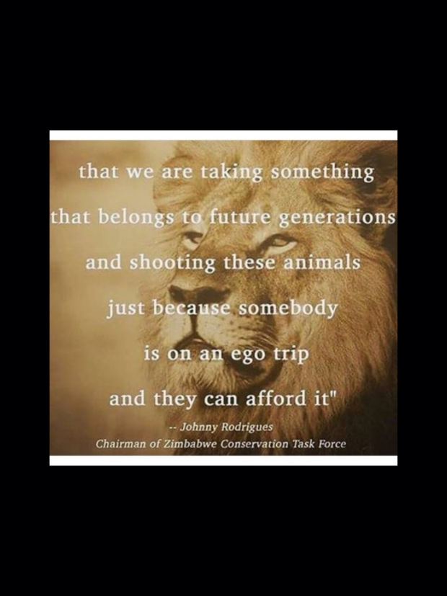
Cases in tourism
Hunting tourism?
Medical tourism?
Sex tourism?
Volunteer tourism?
Enclave (resort) tourism?
© Alexandra Coghlan 2019 Introduction to Sustainable Tourism

Slide 15
Presenting your values to the world
Corporate Social Responsibility
Greenwashing
Greenhushing
© Alexandra Coghlan 2019 Introduction to Sustainable Tourism

Slide 16
Corporate social responsibility
37 different definitions of CSR: broadly how an enterprise should conduct its business in a way that is just and moral, thereby acting as a good corporate citizen that contributes to a better society and a cleaner environment.
5 dimensions of CSR:
Economic, ensuring sustainability in business profits while being mindful to avoid issues of exploitation
Environmental, to ensure best practice in resource use, waste disposal, etc.
Social, including labour practices, human rights, society and product responsibility towards consumers.
Stakeholders, involving proactive sustained long-term healthy relations with employees, suppliers, customers and other secondary stakeholders
Voluntariness, activities which are over and above what is expected by law; maintaining positive relations with stakeholders; doing what is right; and increasing brand capital as a ‘good enterprise’. (Dahlsrud, 2008)
© Alexandra Coghlan 2019 Introduction to Sustainable Tourism

Slide 17
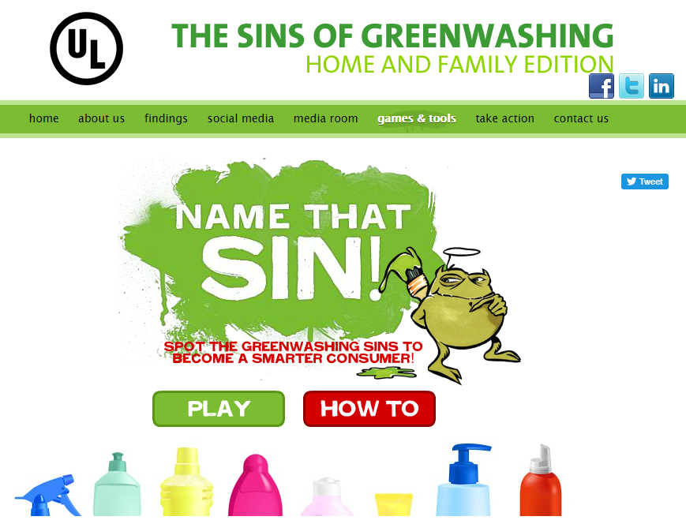
Greenwashing
Falsely promoting green behaviours.
The seven sins of greenwashing:
The Sin of the Hidden Trade-Off, by emphasizing one good practice to distract from another, potentially more serious, practice.
The Sin of No Proof, where no evidence or third-party certification can back up the claims of good practice.
The Sin of Vagueness, where claims are almost meaningless as they are so vague
The Sin of Worshiping False Labels, where an award or other certification-like label is introduced to the packaging, but doesn’t reflect any genuine standard of production
The Sin of Irrelevance, when the claimed good practice is either already illegal or doesn’t make sense in the context (e.g. ??)
The Sin of Lesser of Two Evils, when an environmental claim makes consumers feel 'green' about a product category that is itself lacking in environmental benefits.
The Sin of Fibbing, when claims are outright false.
© Alexandra Coghlan 2019 Introduction to Sustainable Tourism

Slide 18
Greenhusing
The deliberate withholding from customers and other stakeholders of the sustainability-related actions practiced by a business.
The researchers who coined this term say it allows business to bridge the gap between what they think a customer wants and their own position with regards to sustainability.
Some business will greehush up to 70% of their actual sustainability-related behaviours, only reporting the 30% that they feel will not negatively impact on the tourists’ experience (Font et al., 2017).
© Alexandra Coghlan 2019 Introduction to Sustainable Tourism

Slide 19

Speaking up about ethical issues
No clear idea among tourists about what ethical issues exist in tourism
Tourists generally don’t know what to look for or how to ask questions
Conversations around ethics and values take courage -
© Alexandra Coghlan 2019 Introduction to Sustainable Tourism

Slide 20
In sum…
Need to learn to discuss value-laden issues
Business need to take leadership
Don’t rely on business case for sustainability
Practice ethical decision-making, being aware of the different types of ethical positions and some of the barriers to ethical decision-making
Beware of greenwashing
Beware of greenhushing!
And finally
Just because you’re on holiday doesn’t mean anything goes…
© Alexandra Coghlan 2019 Introduction to Sustainable Tourism

